Slide 1
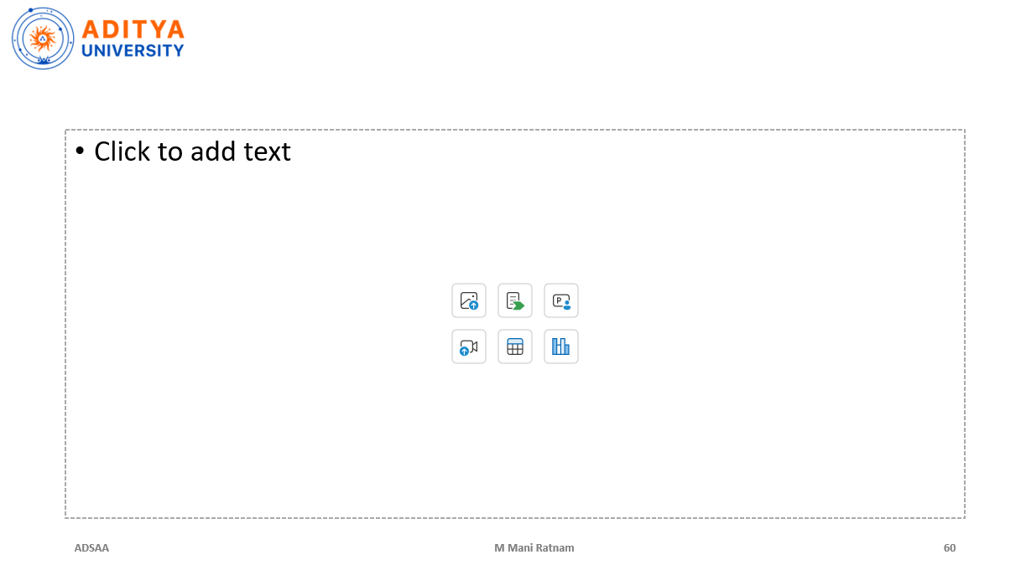
DAE PROJECT:
DAE PROJECT:
WEB SCRAPPING AND PRODUCT PRICE ANALYSIS
WEB SCRAPPING AND PRODUCT PRICE ANALYSIS
BATCH-4:
BATCH-4:
TEAM MEMBERS
TEAM MEMBERS
25B11CS195 : CHOWDARY YASHWANTH
25B11CS793 : PUNNAM SURYA SAI
25B11CS109 : B.MEGHANA
25B11CS639 : N.RAMALAKSHMI
25B11CS195 : CHOWDARY YASHWANTH
25B11CS793 : PUNNAM SURYA SAI
25B11CS109 : B.MEGHANA
25B11CS639 : N.RAMALAKSHMI
25B11CS195
25B11CS793
25B11CS109
25B11CS639
: CHOWDARY YASHWANTH
: PUNNAM SURYA SAI
: B. MEGHANA
: N. RAMALAKSHMI
1
1

Slide 2
Introduction
Web scraping automatically collects useful information from web pages and converts it into structured data.
Our system collects product name, price, discount, rating, reviews, website and product URL.
The collected data is cleaned, analyzed and visualized to generate useful pricing insights.
Core idea: convert web data into actionable information for better price comparison.
2
2

Slide 3
Problem Statement
Products are available on multiple e-commerce platforms with different prices, discounts and ratings.
Manually checking several websites is time-consuming and difficult to repeat for many products.
Users may miss a lower price or a better deal available on another platform.
There is a need for an automated system that collects, compares and analyzes product prices.
3
3

Slide 4
Project Goals
Automate product-data collection from selected web sources.
Clean and preprocess raw scraped data for reliable analysis.
Compare prices, discounts and ratings across platforms.
Calculate minimum, maximum, average and price differences.
Visualize price patterns and trends using charts.
Generate insights such as the lowest price and potential best deal.
4
4

Slide 5
Why is the Project Useful?
Why is the Project Useful?
Business Use
Saves customers time
Finds lower-priced offers
Makes comparison easier
Supports purchase decisions
Can track prices over time
Competitor price monitoring
Market-price analysis
Discount analysis
Product benchmarking
Pricing strategy support
5
5

Slide 6
Proposed System Architecture
User / Product
Keyword
Web
Scraping
Raw
Dataset
Cleaning &
Preprocessing
Price
Analysis
Visualization
& Insights
Raw web information is converted into structured data and then into analytical insights.
6
6

Slide 7
Technologies Used
Technologies Used
Analytics Stack
Python — main programming language
Requests — fetch web pages where appropriate
BeautifulSoup — parse HTML
Selenium — handle dynamically rendered pages
Pandas — data cleaning and analysis
NumPy — numerical operations
Matplotlib / Seaborn — visualization
CSV / SQLite / MySQL — storage
Streamlit — optional interactive dashboard
7
7

Slide 8
Web Scraping Process
Select
source
Request /
Browser
Read
HTML
Locate
fields
Extract
values
Store
records
Raw web information is converted into structured data and then into analytical insights.
8
8

Slide 9
Data Cleaning & Preprocessing
Remove currency symbols and commas from prices.
Convert price and rating fields into numeric data types.
Handle missing values and remove duplicate records.
Standardize product names and website labels.
Validate values before analysis so calculations are reliable.
9
9

Slide 10
Price Analysis
Website | Price
Store A | ₹55,000
Store B | ₹52,000
Store C | ₹57,000
Calculated insight | Min ₹52,000 | Max ₹57,000 | Avg ₹54,667
Example: minimum = ₹52,000 | maximum = ₹57,000 | average ≈ ₹54,667
11
11

Slide 11

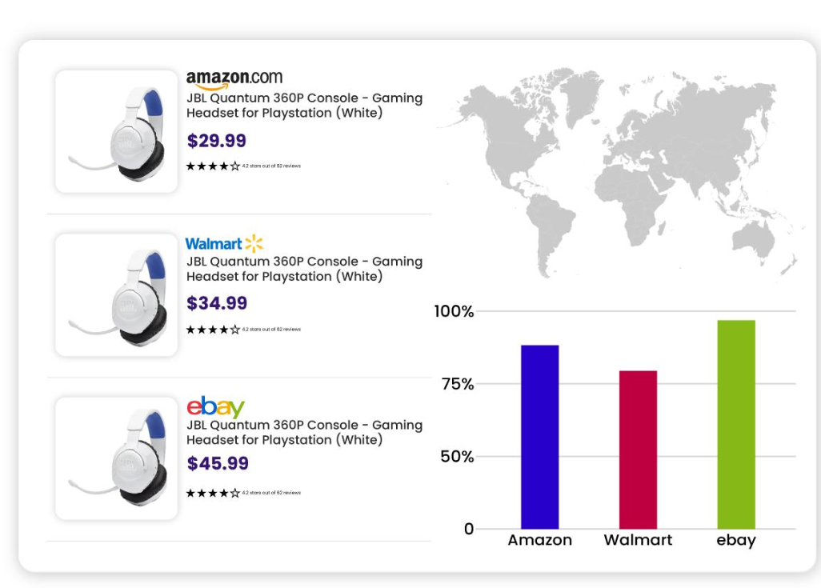

Slide 12
Product Comparison
Product Comparison
Example Insight
Compare the same product across websites.
Identify the minimum and maximum price.
Calculate absolute and percentage price differences.
Compare ratings and review counts.
Rank available offers using selected criteria.
Lowest price → Store B
Highest rating → Store B
Highest review count → Store B
Price difference → ₹5,000
Potential best deal → Store B
The comparison helps identify the most attractive offer using price and product-quality indicators.
12
12
12

Slide 13
Data Visualization
Data Visualization
What the Charts Show
Bar chart — price by website
Line chart — price over time
Scatter plot — price vs rating
Box plot — price distribution
Which store is cheaper
How prices change
Relationship between price and rating
Spread and outliers in prices
13
13

Slide 14
Example Product Dataset
Product | Website | Price | Rating | Reviews
Laptop A | Store A | ₹55,000 | 4.2 | 1,250
Laptop A | Store B | ₹52,000 | 4.5 | 2,100
Laptop A | Store C | ₹57,000 | 4.3 | 900
Laptop B | Store A | ₹61,500 | 4.1 | 780
Cleaned structured data becomes the input for statistical analysis.
10
10

Slide 15
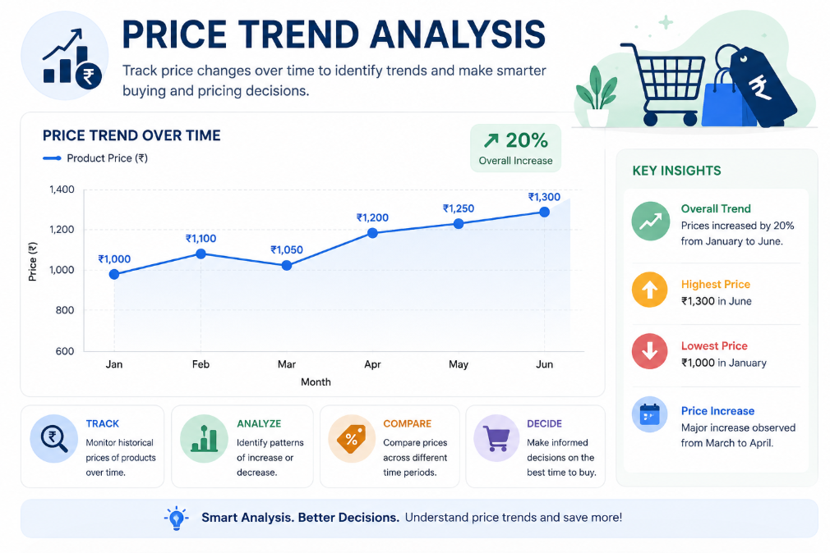
Price Trend Analysis
Store historical prices each time the scraper runs.
Example: ₹55,999 → ₹54,999 → ₹53,999 → ₹52,999 → ₹51,999.
A line chart can reveal price drops,
increases and fluctuations.
Historical data can support future price-alert
and prediction features.
14
14

Slide 16
Possible Outcomes
Lowest available price for a product.
Highest, lowest and average market price.
Price difference between platforms.
Discount and rating comparison.
Historical price trend.
Analytical charts and summarized insights.
A data-driven basis for selecting a better deal.
15
15

Slide 17
Real-World Applications
Real-World Applications
Potential Users
Online shopping price comparison
Competitor price monitoring
E-commerce analytics
Market research
Price monitoring and alerts
Individual customers
Online retailers
E-commerce analysts
Marketing teams
Business decision-makers
16
16

Slide 18
Challenges & Limitations
Challenges & Limitations
Responsible Scraping
Different HTML structures across websites
Dynamic content loaded with JavaScript
Websites may change their page structure
Missing or inconsistent product information
Respect website terms and access rules
Avoid excessive request rates
Use only permitted/publicly accessible data
Handle failures and unavailable pages safely
17
17

Slide 19
Future Enhancements
Future Enhancements
Advanced Version
AI-based product recommendation
Machine-learning price prediction
Automatic price-drop notifications
Sentiment analysis of customer reviews
Interactive Streamlit / Power BI dashboard
Schedule regular scraping
Store historical datasets
Add more product categories
Product matching across websites
Personalized recommendation score
18
18

Slide 20
Conclusion
The system automates the journey from web data collection to analytical insight.
Web scraping provides the raw product data; Pandas and analytics techniques turn it into usable information.
Price comparison identifies differences, trends and potential savings.
The project demonstrates key DAE concepts: data collection, cleaning, preprocessing, analysis and visualization.
Main pipeline: Collect → Clean → Store → Analyze → Compare → Visualize → Insight.
19
19

Slide 21

THANK YOU

